Slide 1
Finding Conflicting Instances of Quantified Formulas in SMT
Andrew Reynolds
Cesare Tinelli
Leonardo De Moura
July 18, 2014

Slide 2
Outline of Talk
SMT solvers:
Efficient methods for ground constraints
Heuristic methods for quantified formulas
⇒ Can we reduce dependency on heuristic methods?
New method for quantifiers in SMT
Finds conflicting instances of quantified formulas
Experimental results
Summary and Future Work

Slide 3
Satisfiability Modulo Theories (SMT)
SMT solvers
Are efficient for problems over ground constraints G
Determine the satisfiability of G using a combination of:
Off-the-shelf SAT solver
Efficient ground decision procedures, e.g.
Uninterpreted Functions
Linear arithmetic
Arrays
Datatypes
…
Used in many applications:
Software/hardware verification
Scheduling and Planning
Automated Theorem Proving
f(3) ≠ f(c)
c=2 ∨ c+1≤0
a+1 = read(A,b)
tail(l₁)=cons(a,l₂)
G

Slide 4
DPLL(T)-Based SMT Solver
f(a) =5 ∨ f(b)=f(c)
f(a)≥10 ∨ read( B, 5 ) ≤ f(c)
G
SMT Solver
SAT Solver
Ground
Theory Solvers

Slide 5
DPLL(T)-Based SMT Solver
f(a) =5 ∨ f(b)=f(c)
f(a)≥10 ∨ read( B, 5 ) ≤ f(c)
G
f(a) =5
f(a)≥10
M
“context”
sat
unsat
SAT Solver
Ground
Theory Solvers
UNSAT

Slide 6
DPLL(T)-Based SMT Solver
f(a) =5 ∨ f(b)=f(c)
f(a)≥10 ∨ read( B, 5 ) ≤ f(c)
G
f(a) =5
f(a)≥10
M
SAT Solver
Ground
Theory Solvers
T-consistent
UNSAT
SAT
T-inconsistent
¬f(a) =5 ∨ ¬f(a)≥10

Slide 7
SMT + Quantified Formulas
SMT solvers have limited support for:
First-order universally quantified formulas Q
Used in an increasing number of applications, for:
Defining axioms for symbols not supported natively
Encoding frame axioms, transition systems, …
Universally quantified conjectures
When universally quantified formulas Q are present, problem is generally undecidable
Approaches for G ∪ Q in SMT are usually heuristic
f(a) =5 ∨ f(b)=f(c)
f(a)≥10 ∨ read( B, 5 ) ≤ f(c)
∀ x. f(x) < 0
G
Q

Slide 8
SMT Solver + Quantified Formulas
f(a) =5 ∨ f(b)=f(c)
f(a)≥10 ∨ read( B, 5 ) ≤ f(c)
G
∀ x. f(x) < 0
Q
SMT solver
SAT Solver
Ground
Theory Solvers
Quantifiers Module

Slide 9
SMT Solver + Quantified Formulas
f(a) =5 ∨ f(b)=f(c)
f(a)≥10 ∨ read( B, 5 ) ≤ f(c)
G
∀ x. f(x) < 0
Q
f(a) ≥10
f(b)=f(c)
M
SAT Solver
Ground
Theory Solvers
Quantifiers Module
Find (T-consistent) context M

Slide 10
SMT Solver + Quantified Formulas
f(a) =5 ∨ f(b)=f(c)
f(a)≥10 ∨ read( B, 5 ) ≤ f(c)
G
∀ x. f(x) < 0
Q
f(a) ≥10
f(b)=f(c)
M
T-sat
SAT Solver
Ground
Theory Solvers
Quantifiers Module
We must answer: “is M ∪ Q consistent?”
Problem is generally undecidable

Slide 11
Quantifier Instantiation
f(a) =5 ∨ f(b)=f(c)
f(a)≥10 ∨ read( B, 5 ) ≤ f(c)
G
∀ x. f(x) < 0
Q
f(a) ≥10
f(b)=f(c)
M
SAT Solver
Ground
Theory Solvers
Quantifiers Module
UNSAT
f(a)<0
f(b)<0
f(c)<0
…
Instantiation-based approaches:
Add instances of quantified formulas, based on some strategy
E.g. based on patterns (known as “E-matching”)

Slide 12
Instantiation-Based Approaches
Complete approaches:
E.g. Complete instantiation, local theory extensions, finite model finding, Inst-Gen
Cons: only work for limited fragments
General approaches:
Heuristic E-matching
Cons: only for UNSAT, highly heuristic, often inefficient

Slide 13
Motivation
In this talk: new method for quantified formulas
Goals:
Reduce dependency on heuristic methods
Applicable to arbitrary quantified formulas
Not goals:
Completeness (thus, focus only on UNSAT)

Slide 14
Ground Theories : Conflicts
f(a)≥10
f(a)=5
…
M
SAT Solver
Ground
Theory Solvers
Quantifiers Module
UNSAT
If M is inconsistent according to ground theory,

Slide 15
Ground Theories : Conflicts
f(a)≥10
f(a)=5
…
SAT Solver
Ground
Theory Solvers
Quantifiers Module
UNSAT
( ¬f(a) ≥ 10 ∨ ¬f(a)=5)
Ground theory solver reports a single conflict clause
Typically, can be determined efficiently

Slide 16
Quantifiers : Heuristic Instantiation?
f(a) ≥ 10
f(c)=f(b)
…
∀x.f(x)<0
M is T-consistent
SAT Solver
Ground
Theory Solvers
Quantifiers Module
UNSAT
The decision problem for M∪Q is undecidable,

Slide 17
Quantifiers : Heuristic Instantiation?
f(a) ≥ 10
f(c)=f(b)
…
∀x.f(x)<0
SAT Solver
Ground
Theory Solvers
Quantifiers Module
UNSAT
E-matching
for (M, G)
f(a)<0
f(b)<0
f(c)<0
…
Add a potentially large set of instances, heuristically
This can overload the ground solver

Slide 18
Conflicting Instances
Can we make the quantifiers module behave more like a theory solver?
Idea: find cases when M ∪ Q is UNSAT:
Find grounding substitution σ
Such that M ¬Qσ
Qσ is a conflicting instance
Notes:
Revise

Slide 19
Conflict-Based Instantiation
∀x.f(x)<0
f(a) ≥ 10
f(c)=f(b)
…
SAT Solver
Ground
Theory Solvers
Conflict-Based
Instantiation
UNSAT
Heuristic
Instantiation
f(a)<0
“conflicting instance”
First, determine if a conflicting instance exists
If not, resort to heuristic instantiation

Slide 20
Limit of Approach
Caveat: No complete method will determine whether a conflicting instance exists for (M,Q)
Thus, our approach:
Uses an incomplete procedure to determine a conflicting instance for (M, Q)
If not, resort to E-matching for (M, Q)
In practice, Step 1 succeeds for a majority of (M, Q)

Slide 21
E-matching vs Conflicting Instances
Ground term
g(b)≠f(a)
b=h(a)
x. f(x) = g(h(x))
Q
M
Trigger term
In example, g(h(x)) matches ground term g(b)
That is:
M g(b)=g(h(x))σ, for σ = {x→a}
⇒ E-matching for (M,Q) returns σ
Notes:
Revise from now on

Slide 22
E-matching vs Conflicting Instances
g(b)≠f(a)
b=h(a)
x. f(x) = g(h(x))
Q
M
In this example, for σ = { x→a }:
Ground terms match each sub-term from Q
M g(b)=g(h(x))σ
M f(a)=f(x)σ
…and the body of Q is falsified:
M f(x)≠g(h(x))σ
⇒ M ∪ Qσ is UNSAT

Slide 23
E-matching vs Conflicting Instances
g(b)≠f(a)
b=h(a)
x. f(x) = g(h(x))
Q
M
In this example, for σ = { x→a }:
Ground terms match each sub-term from Q
M g(b)=g(h(x))σ
M f(a)=f(x)σ
…and the body of Q is falsified:
M f(x)≠g(h(x))σ
⇒ M ∪ Qσ is UNSAT
In paper, limit T to EUF

Slide 24
E-matching vs Conflicting Instances
g(b)≠f(a)
b=h(a)
x. f(x) = g(h(x))
Q
M
Consider flat form of Q:
x y₁ y₂ y₃.
y₁ = f(x) ∧ y₂ = g(y₃) ∧ y₃ = h(x) ⇒ y₁ = y₂
Matching constraints μ
Flattened body Ψ
Conflicting substitution σ for (M, Q) is such that:
M entails μσ
M entails ¬Ψσ

Slide 25
Equality-Inducing Instances
g(b)≠c
d=f(a)
b=h(a)
M
x. f(x) = g(h(x))
Q
What if we relax constraint 2?
Modified example, for σ = { x→a }:
Ground terms match each sub-term from Q
M g(b)=g(h(x))σ
M f(a)=f(x)σ
…but the body of Q is not falsified:
M f(x)≠g(h(x))σ

Slide 26
Equality-Inducing Instances
g(b)≠c
d=f(a)
b=h(a)
M
x. f(x) = g(h(x))
Q
Still, it may be useful to add the instance Q { x→a }
In this example, Q { x→a } entails g(b) = f(a)
{ x→a } is an equality-inducing substitution
Mimics T-propagation done by theory solvers

Slide 27
Instantiation Strategy
InstantiationRound(Q, M)
Return a (single) conflicting instance for (Q, M)
Return a set of equality-inducing instances for (Q, M)
Return instances based on E-matching for (Q, M)
Three configurations:
cvc4 : step (3)
cvc4+c : steps (1), (3)
cvc4+ci : steps (1),(2),(3)

Slide 28
Experimental Results
Implemented techniques in SMT solver CVC4
UNSAT benchmarks from:
TPTP
Isabelle
SMT Lib
Solvers:
cvc3, z3
3 configurations: cvc4, cvc4+c, cvc4+ci

Slide 29
UNSAT Benchmarks Solved
 | cvc3 | z3 | cvc4 | cvc4+c | cvc4+ci
TPTP | 5234 | 6268 | 6100 | 6413 | 6616
Isabelle | 3827 | 3506 | 3858 | 3983 | 4082
SMTLIB | 3407 | 3983 | 3680 | 3721 | 3747
Total | 12468 | 13757 | 13638 | 14117 | 14445
Configuration cvc4+ci solves the most (14,445)
Against cvc4 : 1,049 vs 235 (+807)
Against z3: 1,998 vs 1,310 (+688)
359 that no implementation of E-matching (cvc3, z3, cvc4) can solve
Notes:
Red -> green
Set up next slide : conjecture bc of inst

Slide 30
# Instantiations for Solved Benchmarks
 | TPTP |  | Isabelle |  | SMT lib
 | Solved | Inst | Solved | Inst | Solved | Inst
cvc3 | 5245 | 627.0M | 3827 | 186.9M | 3407 | 42.3M
z3 | 6269 | 613.5M | 3506 | 67.0M | 3983 | 6.4M
cvc4 | 6100 | 879.0M | 3858 | 119.M | 3680 | 60.7M
cvc4+c | 6413 | 190.8M | 3983 | 54.0M | 3721 | 41.1M
cvc4+ci | 6616 | 150.9M | 4082 | 28.2M | 3747 | 32.5M
cvc4+ci
Solves the most benchmarks for TPTP and Isabelle
Requires almost an order of magnitude fewer instantiations
Improvements less noticeable on SMT LIB
Due to encodings that make heavy use of theory symbols
Method for finding conflicting instances is more incomplete

Slide 31
Instances Produced
InstantiationRound(Q, M)
conflicting instance for (Q, M)
equality-inducing instances for (Q, M)
E-matching for (Q, M)
 |  |  | E-matching |  | Conflicting |  | C-Inducing
 |  | IR | IR | # | IR | # | IR | #
smtlib | cvc4 | 14032 | 100.0% | 60.7M
 | cvc4+c | 51696 | 24.3% | 41.0M | 75.7% | 39.1K
 | cvc4+ci | 58003 | 20.0% | 32.3M | 71.6% | 41.5K | 8.4% | 51.5K
TPTP | cvc4 | 71634 | 100.0% | 879.0M
 | cvc4+c | 201990 | 21.7% | 190.1M | 78.3% | 158.2K
 | cvc4+ci | 208970 | 20.3% | 150.4M | 76.4% | 160.0K | 3.3% | 41.6K
Isabelle | cvc4 | 6969 | 100.0% | 119.0M
 | cvc4+c | 18160 | 28.9% | 54.0M | 71.1% | 12.9K
 | cvc4+ci | 21756 | 22.4% | 28.2M | 64.0% | 13.9K | 13.6% | 130.1K
Conflicting instances found on ~75% of IR
cvc4+ci :
Requires 3.1x more instantiation rounds w.r.t. cvc4
Calls E-matching 1.5x fewer times overall
As a result, adds 5x fewer instantiations
Notes:
Simplify numbers, remove cvc4+c?

Slide 32
Details on Solved Problems
For the 30,081 benchmarks we considered:
cvc4+ci solves more (14,445) than any other
359 are solved uniquely by cvc4+c or cvc4+ci
Techniques increase precision of SMT solver
cvc4+ci does not use E-matching 21% of the time
94 benchmarks unsolved by E-matching implementations
Techniques reduce dependency on heuristic instantiation

Slide 33
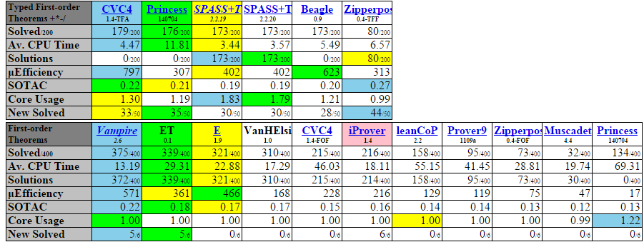
Competitions : CASC J7
Partly due to techniques:
Won TFA division
Finished only behind Vampire/E(s) in FOF division

Slide 34
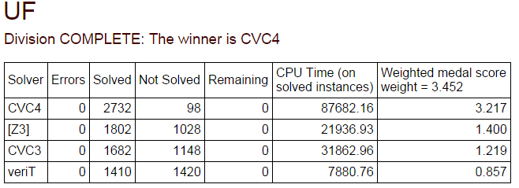
Competitions : SMT COMP 2014
Partly due to techniques:
Official winner in 11 division with quantifiers
(Unofficially) beat z3 in AUFLIA, UFLIA, UF, …

Slide 35
Summary and Future Work
Conflict-based method for quantifiers in SMT
Supplements existing techniques
Improves performance, both in:
Number of instantiations required for UNSAT
Number of UNSAT benchmarks solved
Future work:
More incremental instantiation strategies
Specialize techniques to other theories
Handle quantified formulas containing (e.g.) linear arithmetic
Completeness criteria

Slide 36
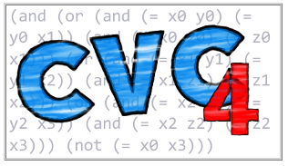
Thank You
Solver is publicly available:
http://cvc4.cs.nyu.edu/
Techniques enabled by option:
“cvc4 --quant-cf …”

