Slide 1
Lazy Proofs for DPLL(T)-Based SMT Solvers
Guy Katz, Clark Barrett, Cesare Tinelli, Andrew Reynolds, Liana Hadarean
Stanford University
The University of Iowa
Synopsys

Slide 2
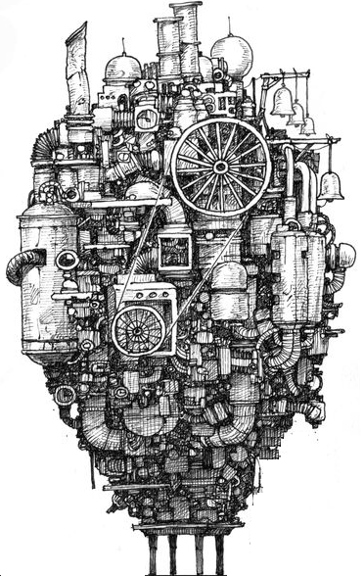
Producing Checkable Artifacts
SMT solvers used in verification & analysis tools
Verifying safety-critical systems
Increase reliability by producing checkable artifacts
Input Query
SMT Solver
Result
$$x⋅2>6 \\ x<5$$
SAT
Check
Model: $$x = 4$$

Slide 3
The UNSAT Case
No satisfying model exists
Input Query
SMT Solver
Result
$$x⋅2>11 \\ x<5$$
?
UNSAT
Check
Proof
$$x⋅2>11$$
$$x<5$$
$$⊥$$

Slide 4
Proofs are Useful
Interpolant generation
Skeptical Proof-Assistants (Coq, Isabelle/HOL)
Discharge goals using SMT-Solver
Reconstruct internal proof from certificate

Slide 5
Our Contributions
Proof production in DPLL(T)-based solvers
Proofs are fine-grained
Extensible: add support for additional theories
Supports combinations of theories
Proofs for the theory of arrays
Lazy proof generation
Solve now, prove later
More efficient
Evaluation in CVC4, available online

Slide 6
Agenda
Background: Proofs in SAT
Proofs in DPLL(T)-Based SMT Solvers
Lazy Proof Production
Theory-Specific Proofs
Experimental Results

Slide 7
Agenda
Background: Proofs in SAT
Proofs in DPLL(T)-Based SMT Solvers
Lazy Proof Production
Theory-Specific Proofs
Experimental Results

Slide 8
Boolean Resolution
The Boolean Resolution rule:
A proof of unsatisfiability:
Start with input clauses
Apply resolution
Derive empty clause
Can always do this for UNSAT formulas
$$p_{1}∨p_{2}∨…∨p_{n}∨c$$
$$\sim c∨q_{1}∨q_{2}∨…∨q_{m}$$
$$p_{1}∨…∨p_{n}∨q_{1}∨…∨q_{m}$$

Slide 9
The DPLL Architecture
An abstract algorithm for solving SAT
Incrementally assign variables to true/false
Decide assignments
Deduce assignments
If formula is satisfied, done
If a conflict is found, backjump
Undo previous decisions, try something else

Slide 10
DPLL: Example
Input clauses (CNF): $1∨\sim 2$, $\sim 1∨\sim 2$, $2∨3$, $\sim 3∨2$
Partial Assignment | Formula | Conflict | Rule Being Applied
 | $$1∨\sim 2\text{, }\sim 1∨\sim 2\text{, }2∨3\text{,} \sim 3∨2$$ |  | Decide
$$1^{d}$$ | $$1∨\sim 2\text{, }\sim 1∨\sim 2\text{, }2∨3\text{,} \sim 3∨2$$ |  | Propagate $\left(\sim 1∨\sim 2\right)$
$1^{d}$, $\sim 2$ | $$1∨\sim 2\text{, }\sim 1∨\sim 2\text{, }2∨3\text{,} \sim 3∨2$$ |  | Propagate $(2∨3)$
$1^{d}$, $\sim 2$, $3$ | $$1∨\sim 2\text{, }\sim 1∨\sim 2\text{, }2∨3\text{,} \sim 3∨2$$ |  | Conflict $(\sim 3∨2)$
$1^{d}$, $\sim 2$, $3$ | $$1∨\sim 2\text{, }\sim 1∨\sim 2\text{, }2∨3\text{,} \sim 3∨2$$ | $$\sim 3∨2$$ | Explain $(2∨3)$
$1^{d}$, $\sim 2$, $3$ | $$1∨\sim 2\text{, }\sim 1∨\sim 2\text{, }2∨3\text{,} \sim 3∨2$$ | $$2$$ | Explain $(\sim 1∨\sim 2)$
$1^{d}$, $\sim 2$, $3$ | $$1∨\sim 2\text{, }\sim 1∨\sim 2\text{, }2∨3\text{,} \sim 3∨2$$ | $$\sim 1$$ | Learn $(\sim 1)$
Conflict: $\sim 3∨2$ Not satisfied by assignment
Clause: $\sim 1∨\sim 2$
$1$ is true $⇒2$ is false
$$\sim 3∨2$$
$$2∨3$$
$1^{d}$, $\sim 2$, $3$ | $$1∨\sim 2\text{, }\sim 1∨\sim 2\text{, }2∨3\text{,} \sim 3∨2,\sim 1$$ | $$\sim 1$$ | Backjump
$$2$$
$$\sim 1$$ | $$1∨\sim 2\text{, }\sim 1∨\sim 2\text{, }2∨3\text{,} \sim 3∨2,\sim 1$$ |  | Propagate $(1∨\sim 2)$

Slide 11
DPLL: Example (cnt’d)
Partial Assignment | Formula | Conflict | Rule Being Applied
$$\sim 1$$ | $$1∨\sim 2\text{, }\sim 1∨\sim 2\text{, }2∨3\text{,} \sim 3∨2,\sim 1$$ |  | Propagate $(1∨\sim 2)$
$$\sim 1\text{, }\text{\sim }\text{2}$$ | $$1∨\sim 2\text{, }\sim 1∨\sim 2\text{, }2∨3\text{,} \sim 3∨2,\sim 1$$ |  | Propagate $\left(2∨3\right)$
$$\text{\sim }\text{1}\text{, \sim }\text{2}\text{, }3$$ | $$1∨\sim 2\text{, }\sim 1∨\sim 2\text{, }2∨3\text{,} \sim 3∨2,\sim 1$$ |  | Conflict $\left(\sim 3∨2\right)$
$$\text{\sim }\text{1}\text{, \sim }\text{2}\text{, }3$$ | $$1∨\sim 2\text{, }\sim 1∨\sim 2\text{, }2∨3\text{,} \sim 3∨2,\sim 1$$ | $$\sim 3∨2$$ | Explain $(2∨3)$
$$\text{\sim }\text{1}\text{, \sim }\text{2}\text{, }3$$ | $$1∨\sim 2\text{, }\sim 1∨\sim 2\text{, }2∨3\text{,} \sim 3∨2,\sim 1$$ | $$2$$ | Explain $(1∨\sim 2)$
$$\text{\sim }\text{1}\text{, \sim }\text{2}\text{, }3$$ | $$1∨\sim 2\text{, }\sim 1∨\sim 2\text{, }2∨3\text{,} \sim 3∨2,\sim 1$$ | $$1$$ | Explain $(\sim 1)$
$$\text{\sim }\text{1}\text{, \sim }\text{2}\text{, }3$$ | $$1∨\sim 2\text{, }\sim 1∨\sim 2\text{, }2∨3\text{,} \sim 3∨2,\sim 1$$ | $$⊥$$ | Fail
$$\sim 3∨2$$
$$2∨3$$
$$2$$

Slide 12
Constructing a Proof
Input clauses: $1∨\sim 2$, $\sim 1∨\sim 2$, $2∨3$, $\sim 3∨2$
$$\text{\sim }\text{1}\text{, \sim }\text{2}\text{, }3$$ | $$1∨\sim 2\text{, }\sim 1∨\sim 2\text{, }2∨3\text{,} \sim 3∨2,\sim 1$$ | $$\sim 3∨2$$ | Explain $(2∨3)$
$1^{d}$, $\sim 2$, $3$ | $$1∨\sim 2\text{, }\sim 1∨\sim 2\text{, }2∨3\text{,} \sim 3∨2$$ | $$\sim 3∨2$$ | Explain $(2∨3)$
$$\text{\sim }\text{1}\text{, \sim }\text{2}\text{, }3$$ | $$1∨\sim 2\text{, }\sim 1∨\sim 2\text{, }2∨3\text{,} \sim 3∨2,\sim 1$$ | $$2$$ | Explain $(1∨\sim 2)$
$1^{d}$, $\sim 2$, $3$ | $$1∨\sim 2\text{, }\sim 1∨\sim 2\text{, }2∨3\text{,} \sim 3∨2$$ | $$2$$ | Explain $(\sim 1∨\sim 2)$
$$\text{\sim }\text{1}\text{, \sim }\text{2}\text{, }3$$ | $$1∨\sim 2\text{, }\sim 1∨\sim 2\text{, }2∨3\text{,} \sim 3∨2,\sim 1$$ | $$1$$ | Explain $(\sim 1)$
$1^{d}$, $\sim 2$, $3$ | $$1∨\sim 2\text{, }\sim 1∨\sim 2\text{, }2∨3\text{,} \sim 3∨2$$ | $$\sim 1$$ | Learn $(\sim 1)$
$$\text{\sim }\text{1}\text{, \sim }\text{2}\text{, }3$$ | $$1∨\sim 2\text{, }\sim 1∨\sim 2\text{, }2∨3\text{,} \sim 3∨2,\sim 1$$ | $$⊥$$ | Fail
$$\sim 3∨2$$
$$2∨3$$
$$2$$
$$\sim 1∨\sim 2$$
$$\sim 3∨2$$
$$2∨3$$
$$\sim 1$$
$$2$$
$$1∨\sim 2$$
$$1$$
$$\sim 1$$
$$⊥$$

Slide 13
Agenda
Background: Proofs in SAT
Proofs in DPLL(T)-Based SMT Solvers
Lazy Proof Production
Theory-Specific Proofs
Experimental Results

Slide 14
Adding the Theory Solvers
DPLL(T): DPLL + Background theory T
Theory atoms mapped to Boolean atoms
SAT solver constructs (partial) assignment
Theory solver checks if it is T-consistent
Theory solvers can:
Report conflicts (T-conflict)
Propagate literals (T-propagate)
Learn new clauses (T-Learn)
Justified by Theory Lemmas

Slide 15
Example: Uninterpreted Functions
$g\left(a\right)=c$, $f\left(g\left(a\right)\right)≠f\left(c\right)∨g\left(a\right)=d$, $c≠d$
$$1$$
$$\sim 2$$
$$3$$
$$\sim 4$$
Partial Assignment | Formula | Conflict | Rule Being Applied
 | $1$, $\sim 2∨3$, $\sim 4$ |  | Propagate $\left(1\right)$, $(\sim 4)$
$1$, $\sim 4$ | $1$, $\sim 2∨3$, $\sim 4$ |  | Decide
$1$, $\sim 4$, $\sim 2^{d}$ | $1$, $\sim 2∨3$, $\sim 4$ |  | T-Conflict ($\sim 1∨2)$
$1$, $\sim 4$, $\sim 2^{d}$ | $1$, $\sim 2∨3$, $\sim 4$ | $$\sim 1∨2$$ | Explain $(1)$
$1$ is true: $g\left(a\right)=c$
$3$ is true: $g\left(a\right)=d$
$4$ is false: $c≠d$
$1$, $\sim 4$, $\sim 2^{d}$ | $1$, $\sim 2∨3$, $\sim 4$ | $$2$$ | Learn $(2)$
$1$ is true: $g\left(a\right)=c$
Congruence: $f\left(g\left(a\right)\right)=f(c)$
Contradicts $\sim 2$
$1$, $\sim 4$, $\sim 2^{d}$ | $1$, $\sim 2∨3$, $\sim 4$, $2$ | $$2$$ | Backjump
$1$, $\sim 4$, $2$ | $1$, $\sim 2∨3$, $\sim 4$, $2$ |  | Propagate $\left(\sim 2∨3\right)$
$1$, $\sim 4$, $2$, $3$ | $1$, $\sim 2∨3$, $\sim 4$, $2$ |  | T-Conflict $(\sim 1∨\sim 3∨4)$
Explain
$1$, $\sim 4$, $2$, $3$ | $1$, $\sim 2∨3$, $\sim 4$, $2$ | $$⊥$$ | Fail

Slide 16
Example: Uninterpreted Functions
$g\left(a\right)=c$, $f\left(g\left(a\right)\right)≠f\left(c\right)∨g\left(a\right)=d$, $c≠d$
$$1$$
$$\sim 2$$
$$3$$
$$\sim 4$$
$1$, $\sim 4$, $\sim 2^{d}$ | $1$, $\sim 2∨3$, $\sim 4$ |  | T-Conflict ($\sim 1∨2)$
$1$, $\sim 4$, $2$, $3$ | $1$, $\sim 2∨3$, $\sim 4$, $2$ |  | T-Conflict $(\sim 1∨\sim 3∨4)$
Theory Proof
Theory Proof
$$\sim 1∨\sim 3∨4$$
$$\sim 2∨3$$
$$\sim 1∨2$$
$$1$$
$$\sim 1∨\sim 2∨4$$
$$1$$
$$2$$
$$\sim 2∨4$$
$$\sim 4$$
$$\sim 2$$
$$2$$
$$⊥$$

Slide 17
Proofs with Theory Lemmas
Construct refutation tree as before
Leaves may be theory lemmas
T-solver needs to support a produceProof() method
Use sub-proof to justify the lemma
Each theory-lemma owned by a specific T-solver
Complex lemmas may have multiple steps
Invoke produceProof() for each step
Combine with Boolean resolution

Slide 18
Agenda
Background: Proofs in SAT
Proofs in DPLL(T)-Based SMT Solvers
Lazy Proof Production
Theory-Specific Proofs
Experimental Results

Slide 19
The Eager Approach
When should we prove theory lemmas?
Eagerly: when lemma is generated
Easy to produce a proof
Many lemmas generated during search
Not all are needed!

Slide 20
The Lazy Approach
No proof production during search
Produce proofs on demand
When theory lemma encountered in refutation tree
Fewer theory proofs generated
But, need to redo some theory reasoning

Slide 21
So, Eager or Lazy?
Eager: more lemmas, less work for each lemma
Lazy: fewer lemmas, each lemma more expensive
Can differ between theory solvers!
Evaluation:
For uninterpreted functions: Lazy
For arrays: Lazy

Slide 22
Lazily Proving Lemmas
Theory lemmas:
Lemmas are disjunctions: $⇒_{T}l_{1}∨l_{2}∨…∨l_{n}$
To prove a previous lemma:
Create a fresh theory solver
Assert: $\sim l_{1}, \sim l_{2},…, \sim l_{n}$
When $⊥$ is derived, call produceProof()
T-Propagation | $$p_{1}∧p_{2}⇒_{T}p_{3}$$ | $$⇒_{T}\sim p_{1}∨\sim p_{2}∨p_{3}$$
T-Conflict | $$p_{1}∧p_{2}⇒_{T} ⊥$$ | $$⇒_{T}\sim p_{1}∨\sim p_{2}$$
T-Learn | $$⇒_{T}p_{1}∨p_{2}$$

Slide 23
Handling Rewrites
Array solver generates a lemma: $\left(b+1=1\right)∨\left(\left(a\left[b+1\right]≔x\right)\left[1\right]=a\left[1\right]\right)$
Bitvector solver performs a rewrite: $\left(b=0\right)∨\left(\left(a\left[b+1\right]≔x\right)\left[1\right]=a\left[1\right]\right)$
Later: ask array solver to prove $ℓ_{2}$
Error!
$$ℓ_{1}:$$
$T_{AX}$-valid
$$ℓ_{2}:$$
not $T_{AX}$-valid

Slide 24
Handling Rewrites (cnt’d)
Solution: track rewrites
Remember a recipe for proving $ℓ_{2}$:
Prove $ℓ_{1}$
Prove rewrite: $\left(b+1=1\right)→(b=0)$
Prove rewrites lazily, with lemmas

Slide 25
Agenda
Background: Proofs in SAT
Proofs in DPLL(T)-Based SMT Solvers
Lazy Proof Production
Theory-Specific Proofs
Experimental Results

Slide 26
Theory-Specific Proofs
For SAT proofs, Boolean Resolution is enough
For background theories, need additional rules
Proof rules correspond to theory solver’s decision procedure

Slide 27
Uninterpreted Functions
Decision procedure: congruence closure
Proof generation proposed by Fontaine et al., 2006
Use Transitivity, Congruence and Symmetry rules

Slide 28
Uninterpreted Functions (cnt’d)
Example: $\left(x≠y\right)∨\left(z≠f\left(y\right)\right)∨\left(f\left(x\right)=z\right)$
Negated: $x=y$, $z=f(y)$, $f\left(x\right)≠z$
$$x=y$$
$$z=f(y)$$
Congruence
Symmetry
$$f\left(x\right)=f(y)$$
$$f\left(y\right)=z$$
Transitivity
$$f\left(x\right)≠z$$
$$f\left(x\right)=z$$
$$⊥$$

Slide 29
Arrays with Extensionality
Decision procedure: congruence closure, plus
Read-over-Write axioms
$i≠j⇒\left(a\left[i\right]≔x\right)\left[j\right]=a\left[j\right]$
$\left(a\left[i\right]≔x\right)\left[i\right]=x$
Extensionality:
$a≠b⇒∃k.a\left[k\right]≠b[k]$
Example: $\left(i=j\right)∨\left(\left(a\left[j\right]≔y\right)\left[i\right]≠x\right)∨(a\left[i\right]=x)$
$$i≠j$$
$$\left(a\left[j\right]≔y\right)\left[i\right]=x$$
Read-over-Write 1
$$a\left[i\right]=x$$
$$a\left[i\right]≠x$$
$$⊥$$

Slide 30
Fixed-Width Bitvectors
Decision procedure: bitblasting
Boolean variables represent individual bits
Proof generation: previous work (LPAR’15)
Example: $\left(b_{1}≠b_{2}\right)∨\left(b_{2}≠10\right)∨(b_{1}≠00)$
$$b_{1}=b_{2}$$
$$b_{2}=10$$
BB
BB
$$b_{1}\left[1\right]=b_{2}\left[1\right]$$
$$b_{2}\left[1\right]=1$$
$$b_{1}=00$$
Transitivity
BB
$$b_{1}\left[1\right]=1$$
$$b_{1}\left[1\right]=0$$
$$⊥$$

Slide 31
Agenda
Background: Proofs in SAT
Proofs in DPLL(T)-Based SMT Solvers
Lazy Proof Production
Theory-Specific Proofs
Experimental Results

Slide 32
Implementation: CVC4
Currently supported theories:
Uninterpreted functions
Arrays with extensionality
Fixed-width Bitvectors
And combinations thereof…
Proofs generated in LFSC format

Slide 33
Evaluation on SMT-LIB
Tested relevant families from SMT-LIB:
QF_UF, QF_AX, QF_BV
QF_UFBV, QF_ABV, QF_AUFBV
Benchmark Category | Default Solved Time |  | Generate Proof Solved Time |  | Generate and Check Proof Solved Time
QF_UF | 4083 | 7523 | 4067 | 19097 | 4029 | 61650
QF_AX | 277 | 450 | 264 | 3170 | 260 | 3193
QF_BV | 20517 | 49884 | 20430 | 67072 | 17602 | 132975
QF_UFBV | 12 | 1391 | 12 | 2623 | 4 | 170
QF_ABV | 4487 | 16223 | 4410 | 19900 | 4127 | 22768
QF_AUFBV | 31 | 93 | 31 | 245 | 30 | 1751
Symbolic Execution | 94 | 1735 | 89 | 4364 | 71 | 2348
Total Solved | 100% |  | 99% |  | 88%

Slide 34
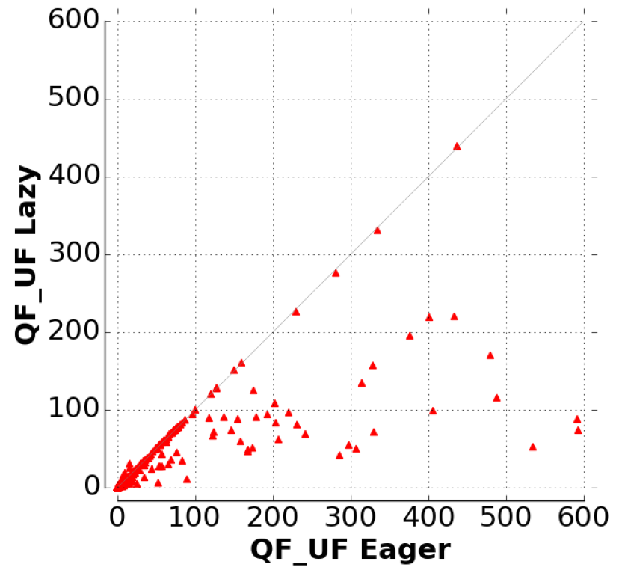
Eager VS Lazy
On average, the lazy approach is:
$23\%$ faster for uninterpreted functions
$20\%$ faster for arrays
Bitvectors: work in progress

Slide 35
Conclusion
Proof production increases confidence in SMT solvers
Extend DPLL(T) with proof production
Extensible, modular and robust
The lazy approach: prove only as needed
CVC4 supports proofs for uninterpreted functions, arrays and bitvectors

Slide 36
Future Work
Support additional theory solvers: arithmetic, strings
Support quantified formulas
Rewrites and preprocessing

Slide 37
Questions
Thank You!

