Slide 1
Verifiable Hierarchical Protocols with Network Invariants on Parametric Systems
Opeoluwa Matthews, Jesse Bingham, Daniel Sorin
http://people.duke.edu/~om26/
FMCAD 2016 - Mountain View, CA

Slide 2
Problem Statement
Goal: design and automated verification of hierarchical protocols
R
R - Root node
I- Internal node
L- Leaf node
…
I
L
I
I
L
L
I
L
L
L
I
L
…
L
L
L
L
I
L
I
Prop. logic formula on leaf states
…
…
Safety property:
Notes:
Normally verify in parameterized model checkers

Slide 3
Problem Statement
Parametric model checkers fall short
  Suitable for flat protocols
  Can’t handle asymmetry in hierarchical protocols
Solution: Design specifically to fit automated techniques
Formally specify class of transition systems – Neo
  Require properties that enable automated safety verification
  Key: Network invariants + parameterized verification
Notes:
Next: illustration of our approach

Slide 4

Illustration of our Approach
R
R - Root node
I- Internal node
L- Leaf node
c3
…
I
L
L
L
Network Invariants
c2
c1
L
I
L
require L Network Invariant
  All proper subtrees P
Behavior along c1 over-approximates c2, c3
Preorder captures states and externally-visible behaviors of subhierarchy
L
L
I
L
I
…
…
Parameterized model Checking
Notes:
Neo framework next

Slide 5
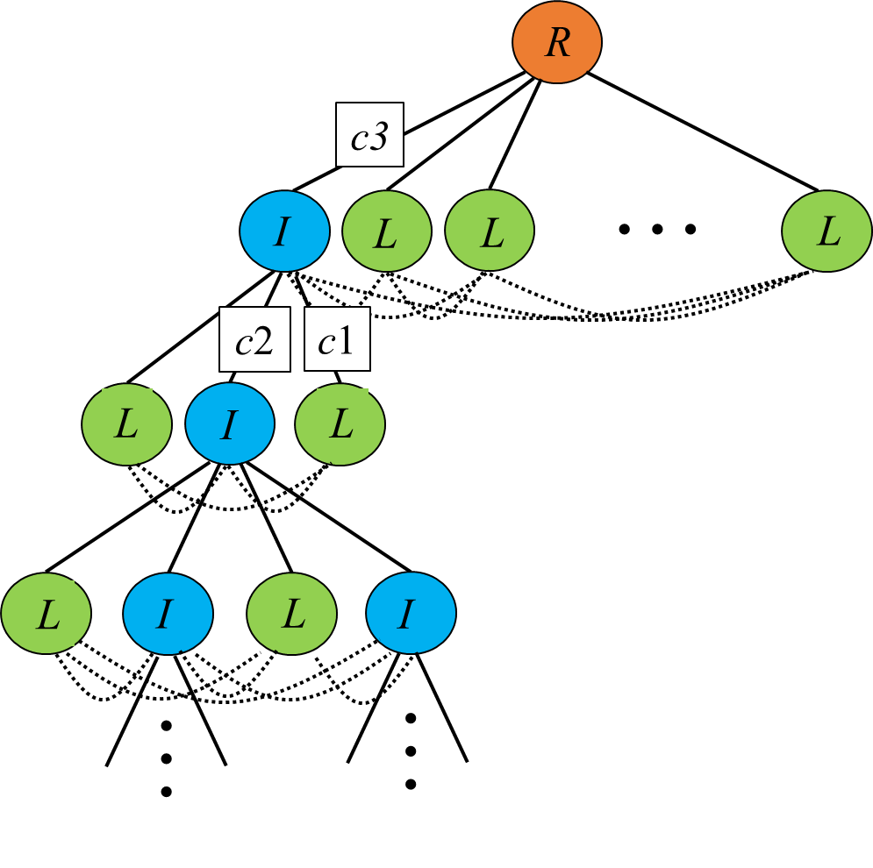
Neo Framework
Neo formalized on I/O Automata (IOA) process theory
Neo system is an IOA with specific properties for actions, composition, and executions
3 classes of IOA
  Internal node
  Leaf node
  Root node
Define 3 sets of actions
  Upward actions – U
  Downward actions – D
  Peer-to-peer actions – P
Notes:
Defining nodes next

Slide 6
Internal Node
n-child k-peer Internal Node I is IOA that:
Communicates with 1 parent, n children, k-1 peers, with index i
u ∈ U, p ∈ P, d ∈ D
(u, i)
(p, i, 0)
(p, i, 1)
(p, i, 2)
(p, i, k-2)
I
. . .
output actions
. . .
(d, 0)
(d, 1)
(d, n-1)
(d, 2)
(d, i)
(p, 0, i)
(p, 1, i)
(p, 2, i)
(p, k-2, i)
I
. . .
input actions
. . .
(u, 0)
(u, 1)
(u, n-1)
(u, 2)

Slide 7
Leaf Node
Leaf node L is 0-child, k-peer internal node:
Communicates with 1 parent and k-1 peers, with index i
u ∈ U, p ∈ P, d ∈ D
(u, i)
(p, i, 0)
(p, i, 1)
(p, i, 2)
(p, i, k-2)
output actions
L
. . .
(d, i)
(p, 0, i)
(p, 1, i)
(p, 2, i)
(p, k-2, i)
L
. . .
input actions

Slide 8
Root Node
n-child Root Node R is IOA that:
Communicates with n children
R
d ∈ D, u ∈ U
. . .
output actions
(d, 0)
(d, n-1)
(d, 1)
(d, 2)
R
. . .
(u, 0)
(u, n-1)
input actions
(u, 1)
(u, 2)
Notes:
Defining Neo systems next

Slide 9
Defining Neo Systems
k-peer Leaf L is Open Neo System, communicates with k-1 peers
0
1
2
k-2
L
. . .

Slide 10


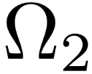

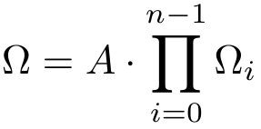
Defining Neo Systems
0
1
2
k-2
. . .
A
…
k-peer internal node A →
k-peer Open Neo System

Slide 11
Defining Neo Systems
A
…
A is root node →
Closed Neo System
Notes:
Network Invariants

Slide 12

Network Invariants on Neo Systems
Network Invariants captures behavior of subhierarchies (open Neo systems)
  Require: Every open Neo system must implement leaf wrt
captures summaries of states and executions
  Summary states
  Summary functions
  Summary sequences of executions
Notes:
Defining summary states next

Slide 13






Summarizing States – Nodes
Sum is set of summary states, with special element bad
Have functions for every Neo system to capture summary state of each subhierarchy
For leaf L, :
For each n-child root or internal node A,
:
implies
Notes:
Summarizing neo systems next

Slide 14

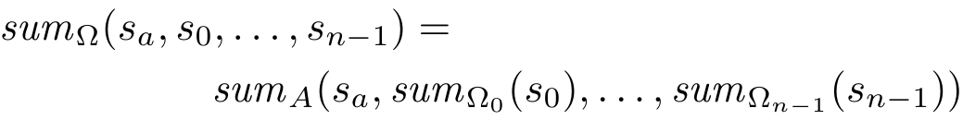
Summarizing States – Neo systems
For Neo system
define
as
Notes:
Defining safety next

Slide 15

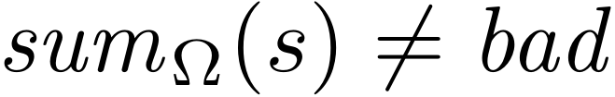

Neo Safety
safe if
safe if all reachable states are safe
Notes:
Summarizing executions next

Slide 16



Summarizing Executions
Generate summary sequence of exec e of as follows:
state
action
summarize states
Remove “silent” terms that don’t affect safety
Delete all
such that
and
Notes:
Preorder for NI next

Slide 17






Neo Preorder Definition
Need preorder for network invariants
Given 2 open Neo systems ,
implies for all executions
there exists execution
such that
Notes:
We’ve defined a bunch of props for Neo systems, props enabled us prove main theorem.

Slide 18
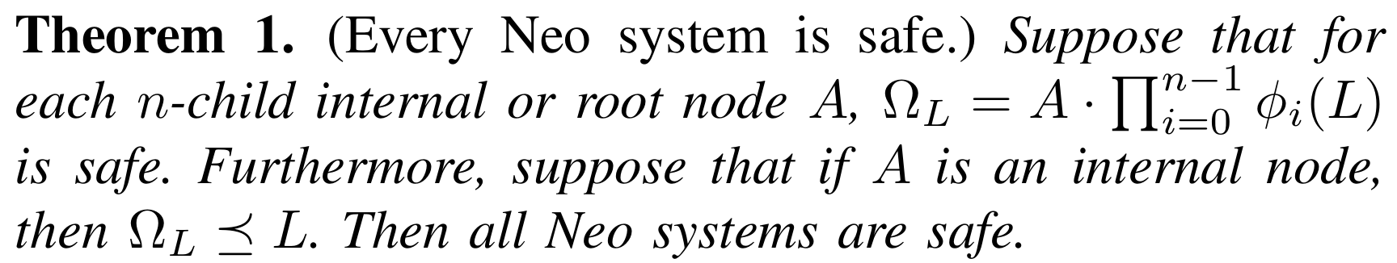
Theoretical Result
Antecedents:
Every 1-level (all-leaf) open or closed neo system safe
Every 1-level (all-leaf) open neo system implements leaf
If 1. and 2. can be performed in parametric model checker
Implication: Reduced 2-dimensional verification problem to 1 dimension
Notes:
Case study next

Slide 19
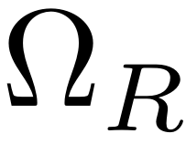
Case Study
We design and verify hierarchical coherence protocol NeoGerman
Modify (originally flat) German protocol into Neo hierarchy
Coherence defined on predicates {E,S,I} on cache states
2 private caches in (E, E) or (E, S) prohibited
D
…
C₀
C₁
C₂
C_{n-1}
Notes:
NeoGerman protocol next

Slide 20


NeoGerman Protocol
Root node is same as directory of German protocol
  is closed Neo system
To get open Neo system , modify directory to be internal node (talk to parent)
Internal node has state variable Permissions, captures summary of subhierarchy
Notes:
Illustration next

Slide 21
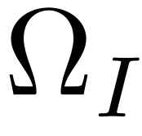
NeoGerman Protocol Illustration
D
Permissions=S
GetExclusive
…
C₀
C₁
C₂
C_{n-1}
I
S
S
S

Slide 22
NeoGerman Protocol Illustration
GetExclusive
D
Permissions=S
…
C₀
C₁
C₂
C_{n-1}
I
S
S
S

Slide 23
NeoGerman Protocol Illustration
GrantExclusive
D
Permissions=E
…
C₀
C₁
C₂
C_{n-1}
I
S
S
S

Slide 24
NeoGerman Protocol Illustration
D
Permissions=E
Inv
Inv
Inv
…
C₀
C₁
C₂
C_{n-1}
I
S
S
S

Slide 25
NeoGerman Protocol Illustration
D
Permissions=E
Ack
Ack
Ack
…
C₀
C₁
C₂
C_{n-1}
I
I
I
I

Slide 26
NeoGerman Protocol Illustration
D
Permissions=E
GrantExclusive
…
C₀
C₁
C₂
C_{n-1}
E
I
I
I
Notes:
Summary functions next

Slide 27



NeoGerman Summary Functions
Preorder, safety defined w.r.t summary functions
Need: if safety violated → function returns bad
Create ordering < on Sum: I < S < E < bad
2 constraints on :
Output of always returns value of Permissions
1)
if
and
2)
Notes:
High level verification methodology next

Slide 28




Verification Methodology
All verification done automated in Cubicle parametric model checker
  SMT-based, backward reachability
  Similar syntax to Murφ, guard/action semantics
  Clean, promising results, great support!
Must prove antecedents of Theorem 1
  and safe – express in Cubicle
  L (preorder) trickier
Notes:
Preorder proof next

Slide 29

Preorder Proof
Model both and L in same Cubicle program
Force and L to transition in lockstep, starting with
Have variables O_action and L_action, represent IOA action, updated after each transition, internal actions updated to (silent)
One each transition, there needs to exist L step that “matches” step
  To reveal witness step, conjunct expression to L guards, forcing L take “right” step w.r.t step.
  Note: conjunction can only restrict L behavior

Slide 30
Preorder Proof
After each step, Cubicle checks:
There exists L action that can fire
  Cubicle safety prop: Disjunction of all L guards is true
After each pair of and L steps, Cubicle checks:
O_action=L_action, summary state outputs match
Notes:
Scope of Neo framework next

Slide 31



What Safety Properties can Neo Verify?
Define class of FOL formulas we can verify are invariant
We can verify all safety properties of the form:
E.g., LP={E,S,I}
We provide summary function guaranteed to verify all such safety properties
Given set of predicates on leaf states and
proposition logic formula over atoms of form
Notes:
Change l to little p

Slide 32
Future Work
  Industrial-strength hierarchical coherence protocol
    Request forwarding
    MESI coherence permissions
    Support for unordered networks
  Distributed lock management
    Richer permissions (NL, CR, CW, PR, PW, EX)
  Dynamic power management
    Natural hierarchy in datacenters
Notes:
Null, concurrent read, concurrent write, protected read, protected write, exclusive

Slide 33
Conclusions
  Neo framework enables design and automated verification of hierarchical protocols safe for arbitrary configurations
  Case study: Design and verify hierarchical coherence protocol
    Correct for arbitrary size, depth, branching degrees per node
    Proof completely automated in parametric model checker
  Prove observational preorder in parametric setting
http://people.duke.edu/~om26/
FMCAD 2016 - Mountain View, CA

