Slide 1
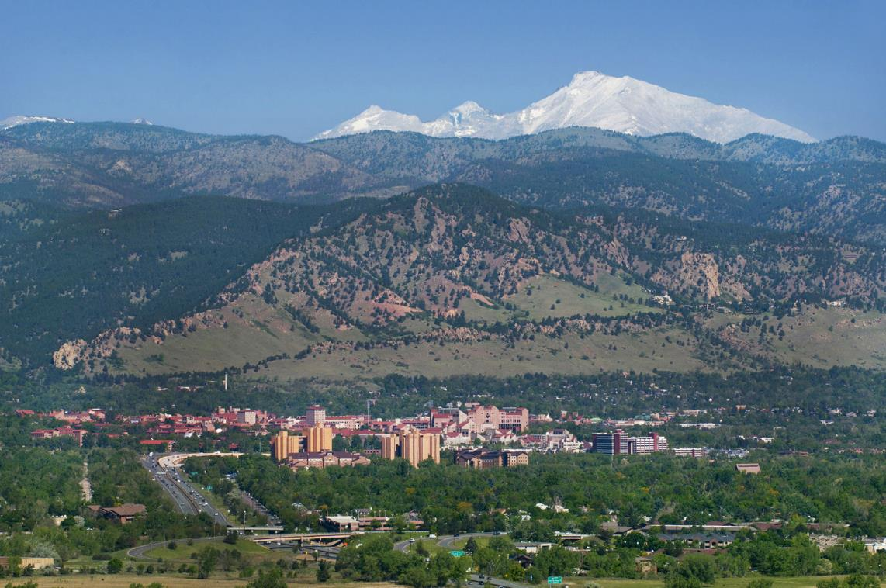
Program Synthesis
for Networks
Pavol Černý
FMCAD
September 2016

Slide 2
Software is eating the world …

Slide 3
… but how do we create all this software?

Slide 4
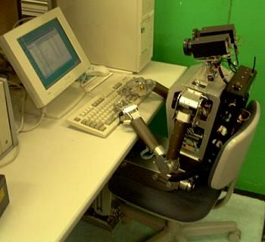
Synthesis?

Slide 5
Program synthesis
What if a programmer could…
sketch the program
give example scenarios
write high-level requirements
describe resource constraints
and the machine
synthesized the program?

Slide 6
Program Synthesis
Specification
Synthesizer
Program
Notes:
6

Slide 7
Program Synthesis
Specification
Input/output examples
Execution
scenarios
Resource constraints
Partial Program
Logical
Specification
Synthesizer
Programmers can express their insights in a variety of ways, not just standard code.
Program
Notes:
7

Slide 8
Program Synthesis for Networks
1. Synthesis of consistent updates
Single updates
Synthesis from specifications.
2. Event-driven network programs
Multiple event-triggered updates
Synthesis from scenarios.

Slide 9
Synthesis of Consistent Updates
Specification
Packet trace specification
Update each switch at most once
Initial and final configuration
Synthesizer
Update Program
Notes:
9

Slide 10
Network
C₁
C₂
A₁
A₂
A₃
A₄
T₁
T₂
T₃
T₄
H₁
H₂
H₃
H₄

Slide 11
Network Configuration
C₁
C₂
A₁
A₂
A₃
A₄
T₁
T₂
T₃
T₄
H₁
H₂
H₃
H₄

Slide 12
Network Update
C₁
C₂
A₁
A₂
A₃
A₄
T₁
T₂
T₃
T₄
H₁
H₂
H₃
H₄
Update program:
upd T1; upd C2; upd A3; upd A1

Slide 13
Network Update Implementation - Naive
C₁
C₂
A₁
A₂
A₃
A₄
T₁
T₂
T₃
T₄
H₁
H₂
H₃
H₄
Possible problem: black holes

Slide 14
Network Update Implementation - Naive
Example: Firewall on A1 and A4.
C₁
C₂
A₁
A₂
A₃
A₄
T₁
T₂
T₃
T₄
H₁
H₂
H₃
H₄
Possible problem: access control violation

Slide 15
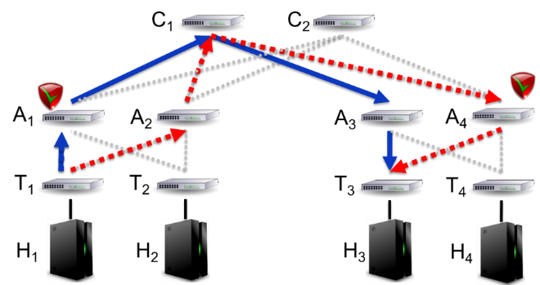
Is this important?
Security
Hospital network traffic cannot bypass HIPAA firewall.
Separation of tenants in data centers.
Performance
Service-level agreements.
Install a set of rules on a switch takes 500-1000 microseconds
at 10 Gigabit per second, a large number of packets can be lost during a sequence of updates.

Slide 16
Is this hard?
Yes, it is hard. The examples are not the whole story.
Networks are large – not 10 switches, but thousands.
Many possible update programs, some incorrect.
There are many types of packets – not just one.
“Obvious” polynomial algorithms do not work –
see DISC 2016.
Need to pause during the update sequence. We do not buffer packets, but might need to “wait” between switch updates.

Slide 17
What do people do currently?
Network operators update configurations manually.
Do manual updates work?
Intention
“At 12:47 PDT on April 21… The configuration change
was to upgrade the capacity of
the primary network.”
Problem started
The traffic shift was executed incorrectly … the traffic was routed onto the lower capacity redundant EBS network.
Problem deepened
“re-mirroring storm”
… (data race, too long timeouts)…
Problem consequences
Quora, Reddit down, problems in Foursquare
Problem solved
April 24

Slide 18
Network Update – Correctness
Per-packet consistency (Reitblatt et al, 2012):
Each packet (even those that are in the network during the update),
takes either the red path or the blue path (but not a mixture of both)
Simple, generic, specification
Questions:
1) Can we implement per-packet consistency by updating the switches in
the right order?
2) If not, can we relax the specification reasonably.

Slide 19
Program Synthesis for Networks
1. Synthesis of consistent updates
Single updates
Synthesis from specifications.
2. Event-driven network programs
Multiple event-triggered updates
Synthesis from scenarios.

Slide 20
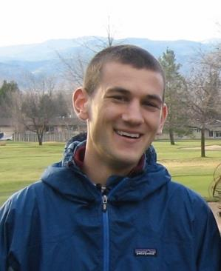
Joint work:
Jedidiah McClurg
CU Boulder
Hossein Hojjat
Cornell
Nate Foster
Cornell

Slide 21
Program Synthesis for Networks
1. Synthesis of consistent update programs
Single updates
Synthesis from specifications.
2. Event-driven network programs
Multiple event-triggered updates
Synthesis from scenarios.

Slide 22
Synthesis of consistent update programs
Why specifications?
Synthesis algorithm
Why is incremental verification important here?
Incremental LTL model checking on loop-free models
Results

Slide 23
Synthesis of consistent update programs
Why specifications?
Synthesis algorithm
Why is incremental verification important here?
Incremental LTL model checking on loop-free models
Results

Slide 24
Network Update Implementation - Correct
C₁
C₂
A₁
A₂
A₃
A₄
T₁
T₂
T₃
T₄
H₁
H₂
H₃
H₄
Update program:
upd T1; upd C2; upd A3; upd A1

Slide 25
Per packet consistency too strong?
Example: Firewall on A1 and A4.
C₁
C₂
A₁
A₂
A₃
A₄
T₁
T₂
T₃
T₄
H₁
H₂
H₃
H₄
Update program: upd A2; upd A4; upd T1; upd C1 does not work.
Update program: upd A2; upd A4; upd C1; upd T1 does not work.
No solution guaranteeing per packet consistency.

Slide 26
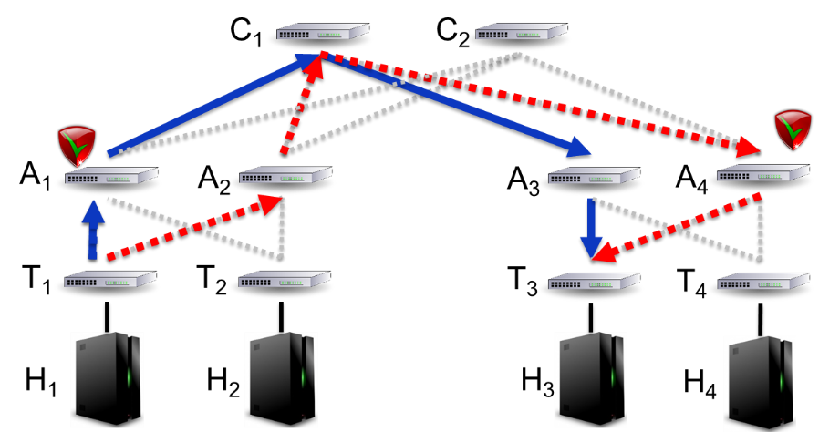
Relaxing per-packet consistency
Application-specific requirements
Each packet (even those that are in the network during the update),
goes from H1 to H3 and traverse either A1 or A4.

Slide 27
Relaxing per-packet consistency
Application-specific requirements
Each packet (even those that are in the network during the update),
goes from H1 to H3 and traverse either A1 or A4.
Update program: upd A2; upd A4; upd T1; upd C1 does not work.
Update program: upd A2; upd A4; upd C1; upd T1 works.

Slide 28
How to specify path properties?
Reachability
“Every packet that starts in $s_{i}$ reaches${ d}_{i}$”
Waypointing
“a packet does not exit the network without passing through w”
Service chaining
“all packets go first through $w_{1}$ and then through $w_{2},$
before exiting the network ”
$$s_{i}$$
$$d_{i}$$
$$w$$
$$g$$
$$w_{1}$$
$$w_{2}$$
$$g$$
These specifications can be expressed in Linear Temporal Logic (LTL).

Slide 29
How to specify path properties? LTL
Reachability
“Every path that starts in $s_{i}$ reaches${ d}_{i}$”
“$\bigwedge_{i}{(port=s_{i} →F port{=d}_{i})}$”
Waypointing
“a packet does not exit the network without passing through w”
“$¬g U w$”
“$F g∧¬g U w$”
Service chaining
“all packets go first through $w_{1}$ and then through $w_{2},$
before exiting the network ”
“$¬g U w_{2}∧¬w_{2}U w_{1}$”
$$s_{i}$$
$$d_{i}$$
$$w$$
$$g$$
$$w_{1}$$
$$w_{2}$$
$$g$$

Slide 30
Program Synthesis for Networks
Specification
Packet trace specification
Update each switch at most once
Initial and final configuration
Synthesizer
Update Program
Notes:
30

Slide 31
Synthesis of consistent update programs
Why specifications?
Synthesis algorithm
Why is incremental verification important here?
Incremental LTL model checking on loop-free models
Results

Slide 32
Algorithm
Depth-first search:
Tries to update switches one-by-one, looking for the correct order, backtracks if a bad configuration is reached.
The search space is huge:
1000 switches to be updated –
$2^{1000}$ $≈{10}^{301}$possible configurations
for each encountered configuration we need to solve the LTL model checking problem
– a computationally hard (PSPACE-complete) problem

Slide 33
Algorithm
Depth-first search:
Tries to update switches one-by-one, looking for the correct order.
Two main ideas:
I. Counterexamples to prune the search space
II. Incremental model checking for LTL

Slide 34
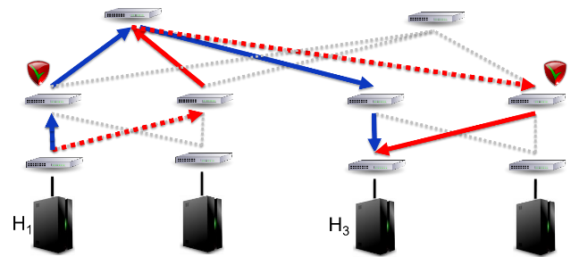
Model Checking
Model M:
Specification S:
all packets reach H3
all packets traverse
Question: Does M satisfy S?

Slide 35
Model Checking
R$∧$ $¬$FW
R$∧$ FW
R$∧$ $¬$FW
R$∧$ $¬$FW
R$∧$ FW
R$∧$FW
R$∧$ $¬$FW
H₁
R$∧$FW
H₃
R$∧$ $¬$FW
R holds at a switch s if all packets that traverse s reach H3
FW holds at a switch s if all packets that traverse s then traverse

Slide 36
Incremental model checking
R$∧$ $¬$FW
R$∧$ FW
R$∧$ $¬$FW
R$∧$ FW
R$∧$ $¬$FW
R$∧$FW
R$∧$ $¬$FW
R$∧$ $¬$FW
R$∧$FW
H₁
R$∧$ $¬$FW
H₃
R$∧$ $¬$FW
R holds at a switch s if all packets that traverse s reach H3
FW holds at a switch s if all packets that traverse s reach

Slide 37
Model checking for LTL
on loop-free structures
One sentence summary:
The idea is the same as in LTL-to-Büchi construction, but on loop-free structures it is possible to check all constraints locally (no need for the Büchi condition).
Labeling by maximally consistent sets of subformulas (and their negations)
Formula $φ=F a∨F b$
Maximally consistent set (example)
$M=\{a,F a, ¬b , ¬F b, (F a∨F b)\}$
A node $n$is labeled by a set $M$ iff there exists a path $σ$ starting at $n$ such that for all formulas $ψ∈M$, we have that $σ⊨ψ$.

Slide 38
Model checking for LTL
on loop-free structures
Labeling sink nodes
Observation: there is only one path $σ$ starting at a sink node.
A sink node $s$ is labeled by $M$ iff
$a$ holds at $s$ iff $a∈M$
…
$X φ∈M$iff $φ∈M$
$φ_{1} U φ_{2}∈M$ iff $φ_{2}∈M$
Important for the overall algorithm:
Eventualities (given by Until) realized at sink nodes “at the latest”
Therefore, all checks are local.

Slide 39
Model checking for LTL
on loop-free structures
Labeling internal nodes
An internal node $n$ is labeled by $M$ iff
…
$X φ_{1}∈M$ iff
there is a child $n’$ of $n$ labeled by $M’$ and $φ_{1}∈M′$
…
${ φ}_{1} U φ_{2}∈M$ iff
either$φ_{2}∈M$
or there is a child $n’$ of $n$ labeled by $M’$ and $φ_{1}∈M$and $φ_{1} U φ_{2}∈M′$

Slide 40
Incremental model checking LTL
$$F a∨ F b$$
$$F a∨ F b$$
$$F a∨ F b$$
K
F a
Update
$$F a∨ F b$$
K
F b
a
b
a
b
a
b
a
b
Example: We are updating the state K.
The label at state K has changed.
The label at its parent has not changed.
We can stop propagating the update.

Slide 41
Synthesis of consistent update programs
Why specifications?
Synthesis algorithm
Why is incremental verification important here?
Incremental LTL model checking on loop-free models
Results

Slide 42
Experiments
Questions
Importance of incremental checking
Scalability
Methodology
Real-world topologies: Topology Zoo, FatTree, Small-World
Properties: Reachability, Waypointing, Service Chaining

Slide 43
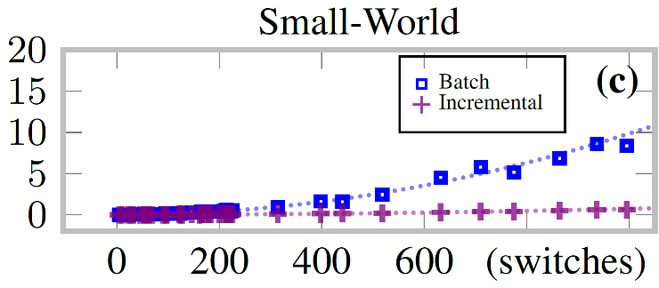
Experiments
importance of incremental checking
Performance using our incremental checker versus our checker in batch mode:

Slide 44
Experiments
Scalability
Synthesizer runtime for large (1K+ updating switches) networks
Runtime for infeasible examples (i.e. examples with no solution)

Slide 45
Program Synthesis for Networks
1. Synthesis of consistent update programs
Single updates
Synthesis from specifications.
2. Event-driven network programs
Multiple event-triggered updates
Synthesis from scenarios.

Slide 46
Event-driven consistent programs
Global network programs describing how a network should react (by updating its configuration) to events
Each event triggers an update
Event-driven update governs when an update should be performed
Program:
ETS: Event transition system
Crisp characterization of efficiently implementable ETSs
Locality condition given by event structure underlying the ETS

Slide 47
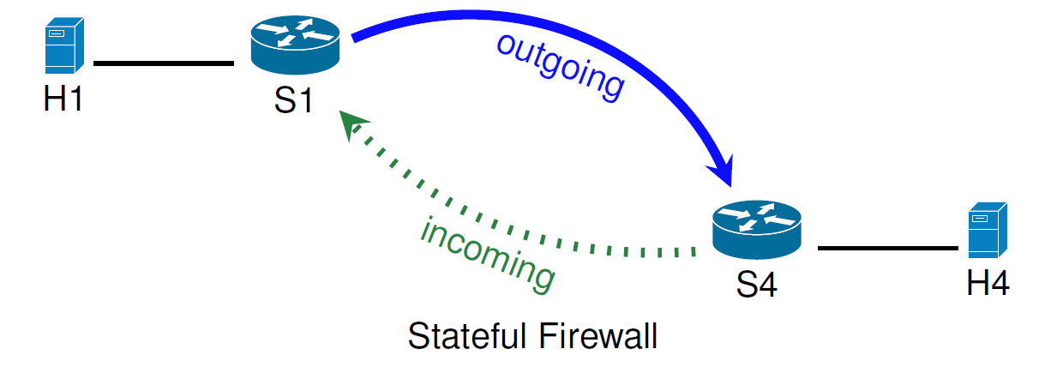
Example 1: Stateful Firewall
H1 can send packets to H4
H4 can send packets to H1 only after H4 receives packets from H1
The first packet from H1 to H4 (event) triggers an configuration update

Slide 48
Example 2: Stateful Firewall with Ack
H1 can send a REQ packet to H4
Once H4 receives the REQ packet from H1, it can send an ACK packet
Afterwards, communication between H1 and H4 is open
Event-1 (REQ packet sent) changes configuration and enables Event-2 (ACK packet can now be sent)

Slide 49
Example 3: Distributed Stateful Firewall
A firewall that authorizes only one of the contacted external hosts
Switch S4 and S5 must somehow resolve conflicting views of which host is authorized.

Slide 50
Example 1: Stateful Firewall
ETS:
e
C1
C2
C1: allow traffic only from H1 to H4
C2: allow both directions
e: a packet from H1 to H4 arrives at S4

Slide 51
Ex. 2: Stateful Firewall with Ack
ETS:
e1
e2
C1
C2
C3
C1: allows REQ packet from H1 to H4
C2: allows ACK packet from H4 to H1
C3: allows both directions
e1: REQ packet at S4
e2: ACK packet at S1

Slide 52
Ex. 3: Distributed Stateful Firewall
C3
e3
ETS:
e2
C1
C2
e4
C4
C1: allows REQ multicast to H4 and H5
C2: allows ACK from H4 and H5
C3: allows only traffic between H1 and H4
C4: allows only traffic between H1 and H5
e1: REQ arrives at S1
e2: ACK from H4 arrives to S4
e3: ACK from H5 arrives to S5

Slide 53
Event-driven consistent update
e
C1
C2
When do we perform the update?
All packets are processed either by C or C’.
If all switches traversed by a packet have heard about event e, the packet is processed by C′.
If all switches traversed by a packet have not heard about e, the packet is processed by C.
We formalize what it means to have “heard about” an event with a happens-before relation ≺ on packet arrivals.

Slide 54
How to handle conflicting events?
Consider a firewall that authorizes only one of the contacted external hosts
Switch S4 and S5 must somehow resolve conflicting views of which host is authorized.
Can this program be implemented efficiently?

Slide 55
Atomicity?
Atomicity is expensive -
requires packet buffering

Slide 56
Locality condition
C3
e3
ETS:
e2
C1
C2
e4
C4
Locality condition:
Events that are simultaneously enabled and in conflict can only occur at the same switch.

Slide 57
Main result
Theorem:
Event-driven network programs can be implemented efficiently
iff
Locality condition: Events that are simultaneously enabled and in conflict can only occur at the same switch
Efficient implementation: a switch is guaranteed to process each packet within a given time bound (excludes packet buffering).

Slide 58
Main result - negative
Theorem:
Event-driven network programs can be implemented efficiently
implies
Locality condition: Events that are simultaneously enabled and in conflict can only occur at the same switch
Proof:
Inspired by Consistency-Availability-Partition Tolerance (CAP) theorem
Intuition: Switches would have to buffer packets while synchronizing with other switches (locality condition prevents this)

Slide 59
Main result - positive
Theorem
Locality condition: Events that are simultaneously enabled and in conflict can only occur at the same switch
implies
Event-driven network programs can be implemented efficiently
Algorithm:
-Packets stamped at their ingress port to fix a configuration in which they will be processed
-Packets propagate information about events that occurred

Slide 60
How to check the locality condition?
We need to infer the enabling and conflict relations on events from the ETS.
We need to infer the underlying event structure (Wynskel).

Slide 61
How to check the locality condition?
C2
C2
e1
e1
e2
C1
vs
C1
C4
e2
e2
e1
C3
C3
e1 and e2 are enabled
e1 and e2 are in conflict
e1 and e2 are enabled

Slide 62
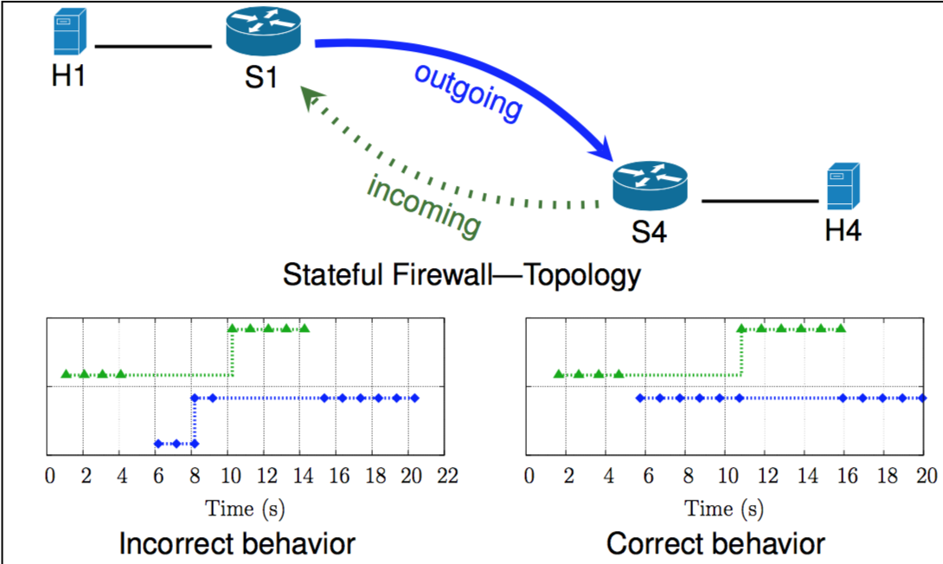
Case study – stateful firewall
Compared correct implementation vs. “uncoordinated” updates

Slide 63
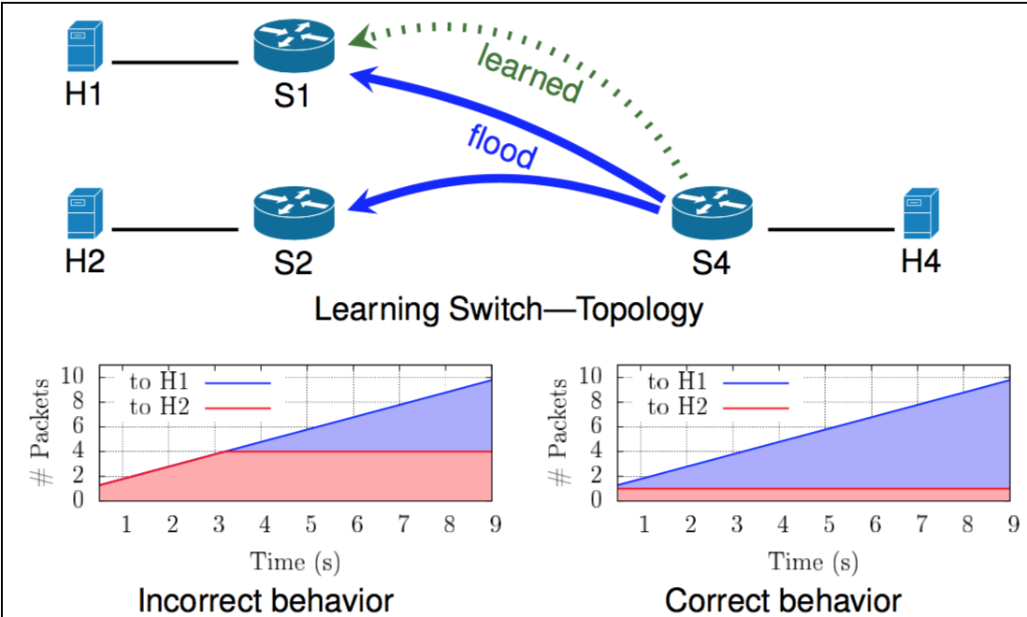
Case study – learning switch
Compared correct implementation vs. “uncoordinated” updates

Slide 64
Event-driven consistent programs
Global network programs describing how a network should react (by updating its configuration) to events
Each event triggers an update
Event-driven update governing when an event should be performed
Program:
ETS: Event-driven transition system
Crisp characterization of efficiently implementable ETSs
Locality condition given by event structure underlying the ETS

Slide 65
Synthesis from scenarios – stateful firewall
Positive scenarios:
H1 s1 s4 H4 H1 s1 s4 H4 s4 s1 H1 H4
H1 s1 s4 H4 s4 s1 H4 H1
Negative scenarios:
H4 s4 s1 H1 H1 s1 H4 s4 s1 s4 H4 H1

Slide 66
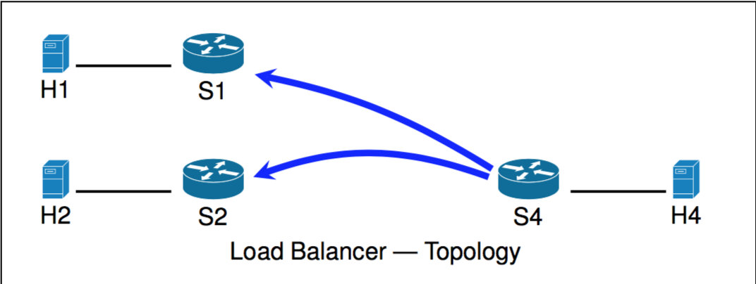
Synthesis from scenarios – load balancer
Positive scenarios:
H4 s1 s4 H1 H4 s4 s1 H1 H4 s4 s2 H2
H4 s4 s1 H1 H4 s4 s2 H2 H4 s4 s1 H1
H4 s4 H4 s4 s2 H2 s1 H1
Negative scenarios:
H4 s4 s1 H1 H4 s4 s1 H1

Slide 67
Synthesis from scenarios
Many other stateful network applications: intrusion detection, access control, tenant isolation in data centers. Maintained by adding/deleting scenarios?
Given scenarios, infer:
Configurations. Events and corresponding updates. Control structure: enabling and conflicts relations on events.

Slide 68
Related Work:
Consistent updates [SIGCOMM’12.]
Network verification
VeriFlow [NSDI ’13]
Header Space Analysis [NSDI ’12]
NetPlumber [NSDI ’13]
Network update synthesis
zUpdate [SIGCOMM ’13]
SWAN [SIGCOMM ’13]
Dionysus [SIGCOMM ’14]
Waypoint Enforcement (WPE) [HotNets ’14]
Customizable Consistency Generator [NSDI ’15]
Languages, verification, and synthesis for networks is a booming area!
NetEgg [CoNEXT’15]
Network programming languages
Frenetic [POPL’12]
NetKAT [POPL’14]
Maple [SIGCOMM’13]
FlowLog [NSDI’14]
Kinetic [NSDI’15]
SNAP [SIGCOMM’16]
Domino [SIGCOMM’16]

Slide 69
References:
Efficient Synthesis for Network Updates. J. McClurg, H. Hojjat, P. Cerny, N. Foster. PLDI 2015.
Event-Driven Network Programming. J. McClurg, H. Hojjat, N. Foster, P. Cerny. PLDI 2016.
Optimal Consistent Network Updates in Polynomial Time. P. Cerny, N. Foster, N. Jagnik, J. McClurg. DISC 2016.
Synthesis of consistent updates in polynomial time.
Optimizing Horn Solvers for Network Repair. H. Hojjat, P. Ruemmer, J. McClurg, P. Cerny, N. Foster. FMCAD 2016.
Automatically repairing buggy network configurations.

Slide 70
Conclusion
1. Synthesis of consistent update programs
Single updates
Synthesis from specifications.
2. Event-driven consistent programs
Multiple event-triggered updates
Synthesis from scenarios.

Slide 71
Program Synthesis
for Networks
Pavol Černý
FMCAD
September 2016

